Slide 1

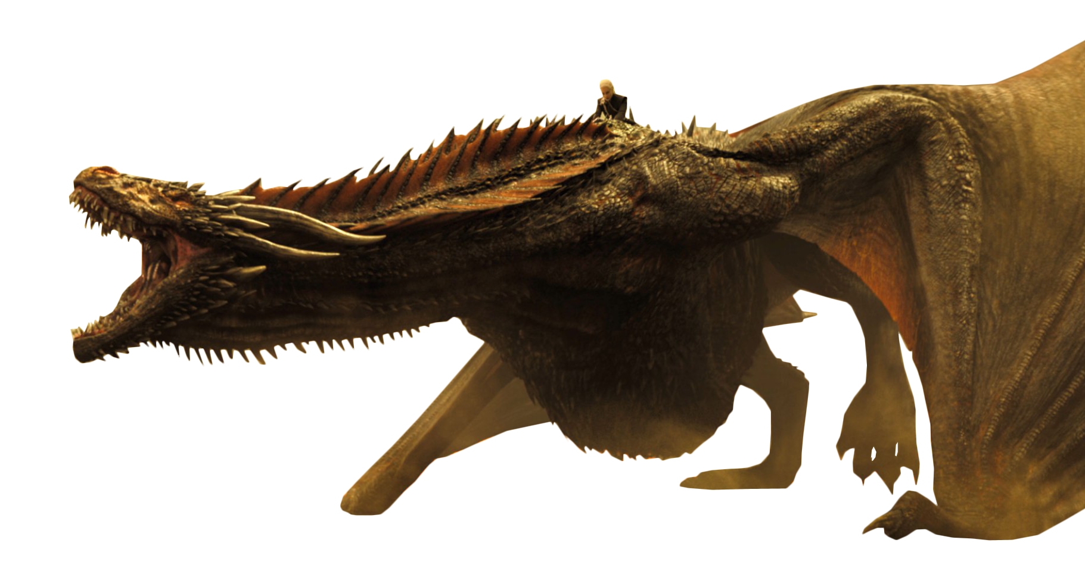
Would you survive?
Josh Ahyong - Rui Pinto - Carmen Santana - Franziska Steger

Slide 2
Approach
Data
Models
Feature Engineering
User Interface

Slide 3
Approach
Data
Models
Feature Engineering
User Interface

Slide 4
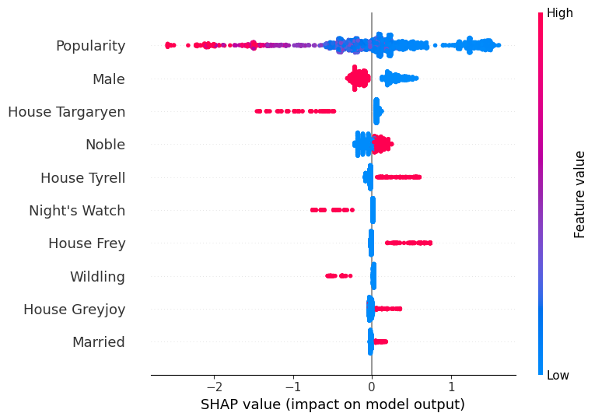
Feature importance
Dead
Alive
Popular
Male Gender
House Targaryen
Noble
Yes
No
House Tyrell
Night's Watch
1
0
Night's Watch
House Frey
Wildling
House Greyjoy
Married
Impact on model prediction

Slide 5
Approach
Data
Models
Feature Engineering
User Interface

Slide 6
Approach
Data
Models
Feature Engineering
User Interface

Slide 7

Try it out!

